Slide 1
The Friendship Paradox
By: James Pindell
CS 532/432 Web Science
4/17/2018

Slide 2

What is the Friendship Paradox?
It’s a phenomenon that states, on average, your friends have more friends than you do
Can be applied to other types of relationships [1]
It was first observed by the sociologist Scott L. Feld in 1991 [1]

Slide 3

Scott L. Feld
In May 1991, he wrote an article that describes the Friendship Paradox, called: “Why Your Friends Have More Friends Than You Do”
Specifically, he looked at the data from a study called “The Adolescent Society”, which dates back to 1961[3]
Example: relationships of eight girls in a high school in “Marketville” [3]
Notes:
Photo Reference: [2]

Slide 4




Social Networks
The main “goal” of social networking services is to connect people to other people
Popular Social Networking Services:
Facebook
Twitter
Snapchat
Instagram

Slide 5

Mathematically Speaking…
Example: Twitter Followers
Your Twitter Follower Count = 10
Followers’ Follower Count =
{5, 10, 15, 20, 25, 30, 35, 40, 45, 50}
Find the average of Followers’ Follower Count:
(Sum of Followers’ Follower Counts) / (Your Follower Count)
(5 + 10 + … + 50) / (10) = 27.5

Slide 6

Does the Friendship Paradox Hold?
Compare Your Follower Count to the Average
If Your Follower Count > Average:
Friendship Paradox Doesn’t Hold
If Your Follower Count < Average:
Friendship Paradox Holds

Slide 7
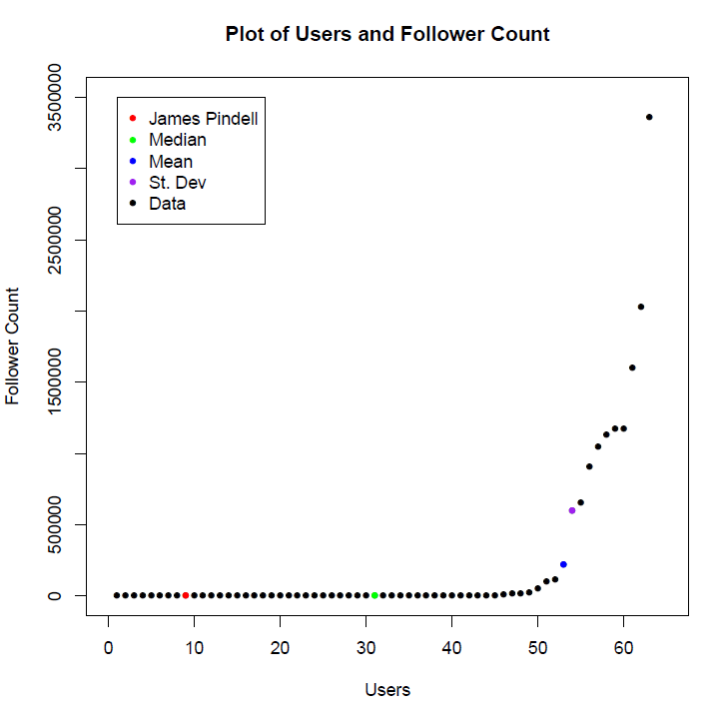
My A4 Results

Slide 8
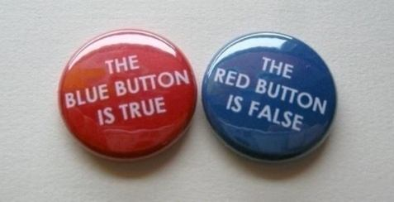
Food For Thought
What if the Friendship Paradox held for persons A and B who are both friends (at least on social media)?
…It’s a Paradox!

Slide 9
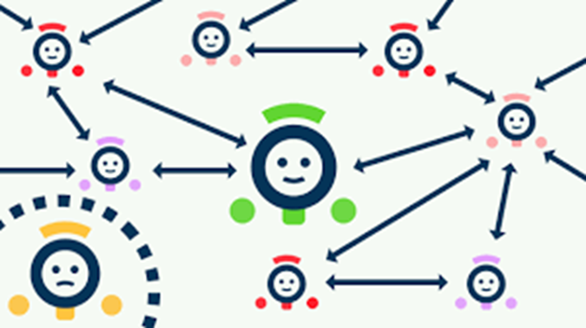
Conclusion
We can see that by looking at individual cases, the Friendship Paradox does indeed hold, at least most of the time
But, there are some flaws and/or loopholes that can negate the validity of the Friendship Paradox

Slide 10
References
[1] https://en.wikipedia.org/wiki/Friendship_paradox
[2] https://www.cla.purdue.edu/sociology/directory/?p=Scott_Feld
[3] http://www.macroeconomics.tu-berlin.de/fileadmin/fg124/networks/Lectures/Summer2012/Material/American_Journal_of_Sociology_1991_Feld.pdf
[4] https://upload.wikimedia.org/wikipedia/commons/thumb/7/7c/Facebook_New_Logo_%282015%29.svg/2000px-Facebook_New_Logo_%282015%29.svg.png
[5] https://a.slack-edge.com/ae7f/img/services/twitter_512.png
[6] https://pmcvariety.files.wordpress.com/2017/11/snapchat-logo.jpg?w=700&h=393&crop=1
[7] https://image.freepik.com/free-vector/instagram-icon_1057-2227.jpg
[8] https://i.ytimg.com/vi/-wkr_vf18cw/maxresdefault.jpg
[9] https://technologyadvice.com/wp-content/uploads/2015/02/compare-crms-like-a-pro-01.png
[10] https://qph.fs.quoracdn.net/main-qimg-b4df1f6ddbd582e747268ea58e36fad3-c
[11] http://godlessmom.com/wp-content/uploads/2015/05/Question-mark-red-3D-glossy.jpg
[12] http://cdn.playbuzz.com/cdn/8c6aa947-3158-49f1-a231-ec89a57e7f21/cc7bb3ce-090e-4b3f-b5db-595f4197fb0a_560_420.jpg
Notes:
References [4] – [12] are for the pictures used in the presentation

Slide 11

Questions?

